Slide 1
Power analyzer
Ryan Rabello & Nathan Zimmerly
Advisor: Dr. Rob Frohne
Notes:
Ryan
Introduce us & sponsor.
Out project is to design Power Analyzer
But before we get to that lets talk about power consumption.
According to the United Nations, “Households consume 29 percent of global energy and consequently contribute to 21 percent of resultant CO2 emissions.”
Furthermore the CIA reports that the US is the second largest electricity consumer,
Which means we are responsible for a large portion of those CO2 emissions.

Slide 2
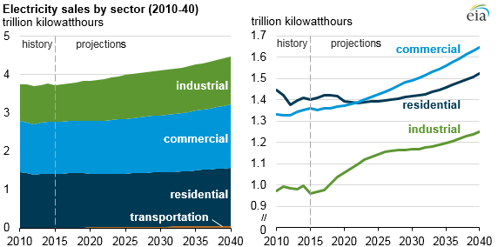
Facts and statistics
Notes:
Ryan
These graphs show the projected increase in power consumption which isn’t good for our environment or your wallet.

Slide 3
Objective
To lower power consumption through intuitive data visualization.
Notes:
Ryan

Slide 4
What is a power analyzer?
Breaks down power consumption data.
Graphs of power usage trends.
Notifications for various power usage events.
Power bill predictions.
Notes:
Nathan
Heat pump! Coolant Leaked, resistive heating turned on.
Possible array of numbers vs graph.

Slide 5
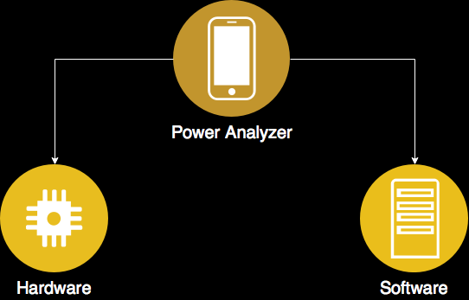
Project Block Diagram
Notes:
Nathan

Slide 6
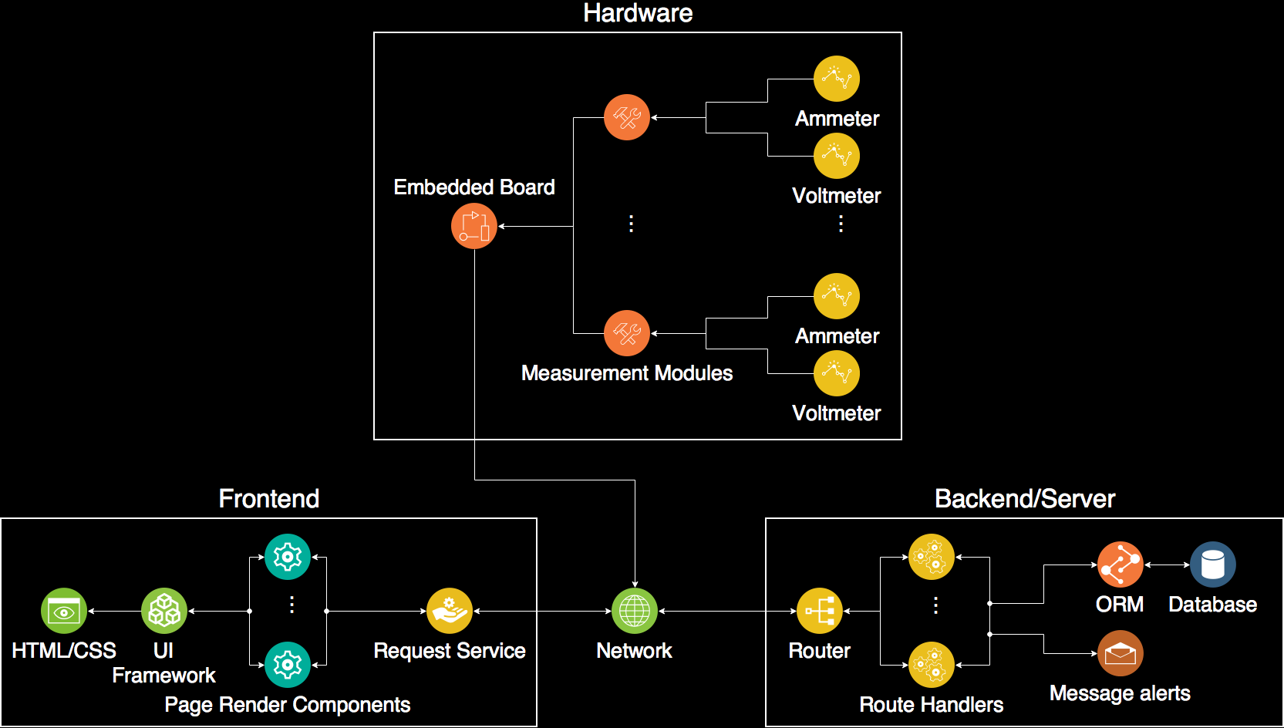
Breakdown
Notes:
Ryan
The software will have two separate modules the frontend (web browser) and the backend or server.
All the modules (including Nathan’s hardware) will connect to the Server through the network.
CLICK
The function of the backend is to receive and respond to requests.
The router will route requests to their corresponding route handler.
The route handlers will store or retrieve data from the database or send an alert then generate a response to the request.
CLICK
The function of the frontend is to receive the stored data and display that data.
The frontend will do this by
Requesting data from the server using the request service.
The page render components transform that data so that the UI framework can convert it to HTML/CSS.

Slide 7
Goals
Requirements
Build an embedded device for data collection
Store data from embedded device
Display information online
Event Notifications
Ideal goals
Authentication
Electric bill prediction
In-depth data analysis
Export data feature
Notes:
Ryan
Requirements
Build an embedded device for data collection
Store data from embedded device
Display information online
Event Notifications
Ideal goals
Authentication & User management
Electric bill prediction
In-depth data analysis which would calculate what time of day on average you consume the most energy.
Export data feature
Low cost (optimize cost)

Slide 8
Stretch Goals
Consumption classification using machine learning
Solar power generation monitoring
Notes:
Ryan
If we happen to finish our entire project mid winter we’re hoping to work on a couple other things.
We’d like to be able to classify the types of devices connected to individual breakers.
We want to not only be able to calculate power usage per breaker but also per device.
Large power consumers like an electric stove or water heater have different capacitance and inductance.
By observing the effects of this capacitance or inductance, we hope to use some machine learning to classify devices.
If we implement this we would be able to tell that Nathan's room is using more electricity because of his space heater.
Solar power Generation
We would eventually like to be able to also account for power generation in our design.
This is not a high priority because Dr. Frohne’s solar array is isolated from the main pannel??

Slide 9
Similar products
Neurio Home Energy Monitoring system ($240)
Sense ($200)
TED Pro Home with Spyder module ($300 + $170)
Curb ($400)
Notes:
Nathan
Neurio Home - Inconsistent when identifying large devices.
Sense – Only gives data for main feeds. Doesn’t break down into each breaker.
TED Pro Home – Goes down to each breaker but expensive.
CURB – Expensive

Slide 10
Estimated Cost per sub-panel
Embedded board ($30)
Measurement Module ($5 + $3/breaker)
Miscellaneous Electrical Components ($20)
Total : $85 (10 breakers)
Notes:
Nathan

Slide 11
Schedule
Dec 17, '17
Jan 14, '18
Feb 11, '18
Mar 11, '18
Apr 8, '18
May 6, '18
Designing embedded module - Nathan 11/29/17 - 2/12/18
Frontend – Ryan & Nathan 2/16/18 - 4/5/18
Design review 4/6/18 - 4/12/18
Design revision 4/13/18 - 4/26/18
Draft report 4/27/18 - 5/3/18
Presentation 5/4/18 - 5/10/18
Report 5/11/18 - 5/15/18
Poster 5/16/18 - 5/22/18
Backend - Ryan 11/29/17 - 2/26/18
Notes:
Ryan
This is our project schedule.
Started working concurrently on the embedded module and the Backend.
When we complete those in February Nathan and I are going to begin working on the frontend.
The frontend should be finished mid April at which point we will begin working on our report, presentation, and other miscellaneous deliverables.

Slide 12
Sources
UN Quote - http://www.un.org/sustainabledevelopment/sustainable-consumption-production/
CIA Quote - https://www.cia.gov/library/publications/the-world-factbook/rankorder/2233rank.html
Figure 1 - U.S. EIA https://www.eia.gov/todayinenergy/detail.php?id=26672
Notes:
Ryan
These are the links to the two quotes and image. I can email them to you if you like.

Slide 13
Questions?
Notes:
Ryan
What will the server run on?
What if there’s more than one breaker box?

